Slide 1
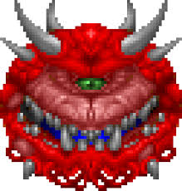

The Effects of Active Vision on Reinforcement Learning Model Performance
A 4th Level (Honours) Project By Rhys Stewart

Slide 2
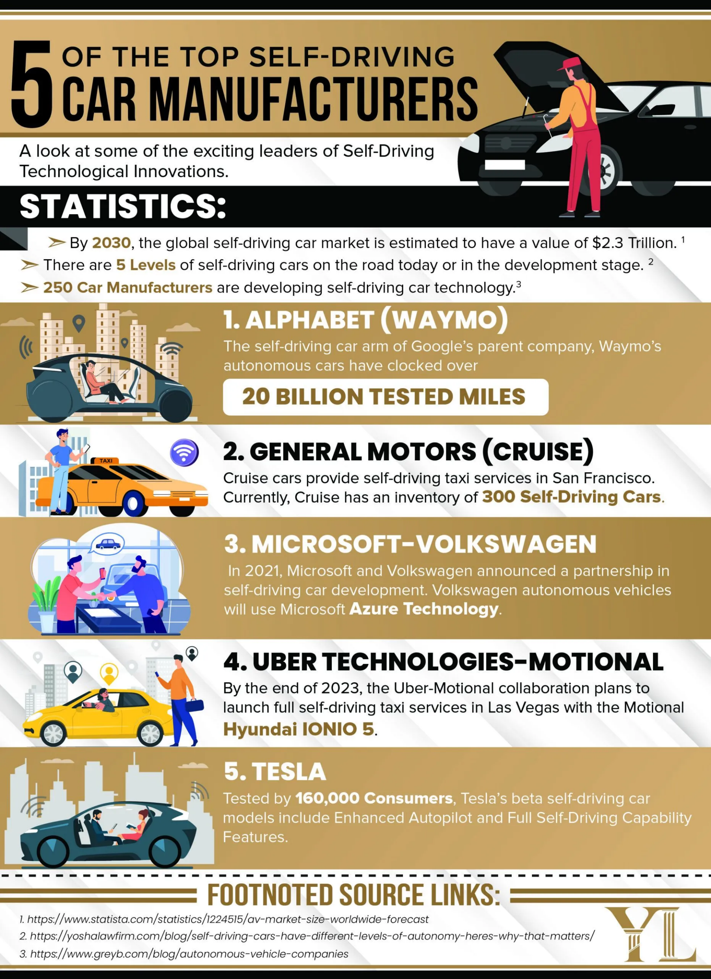
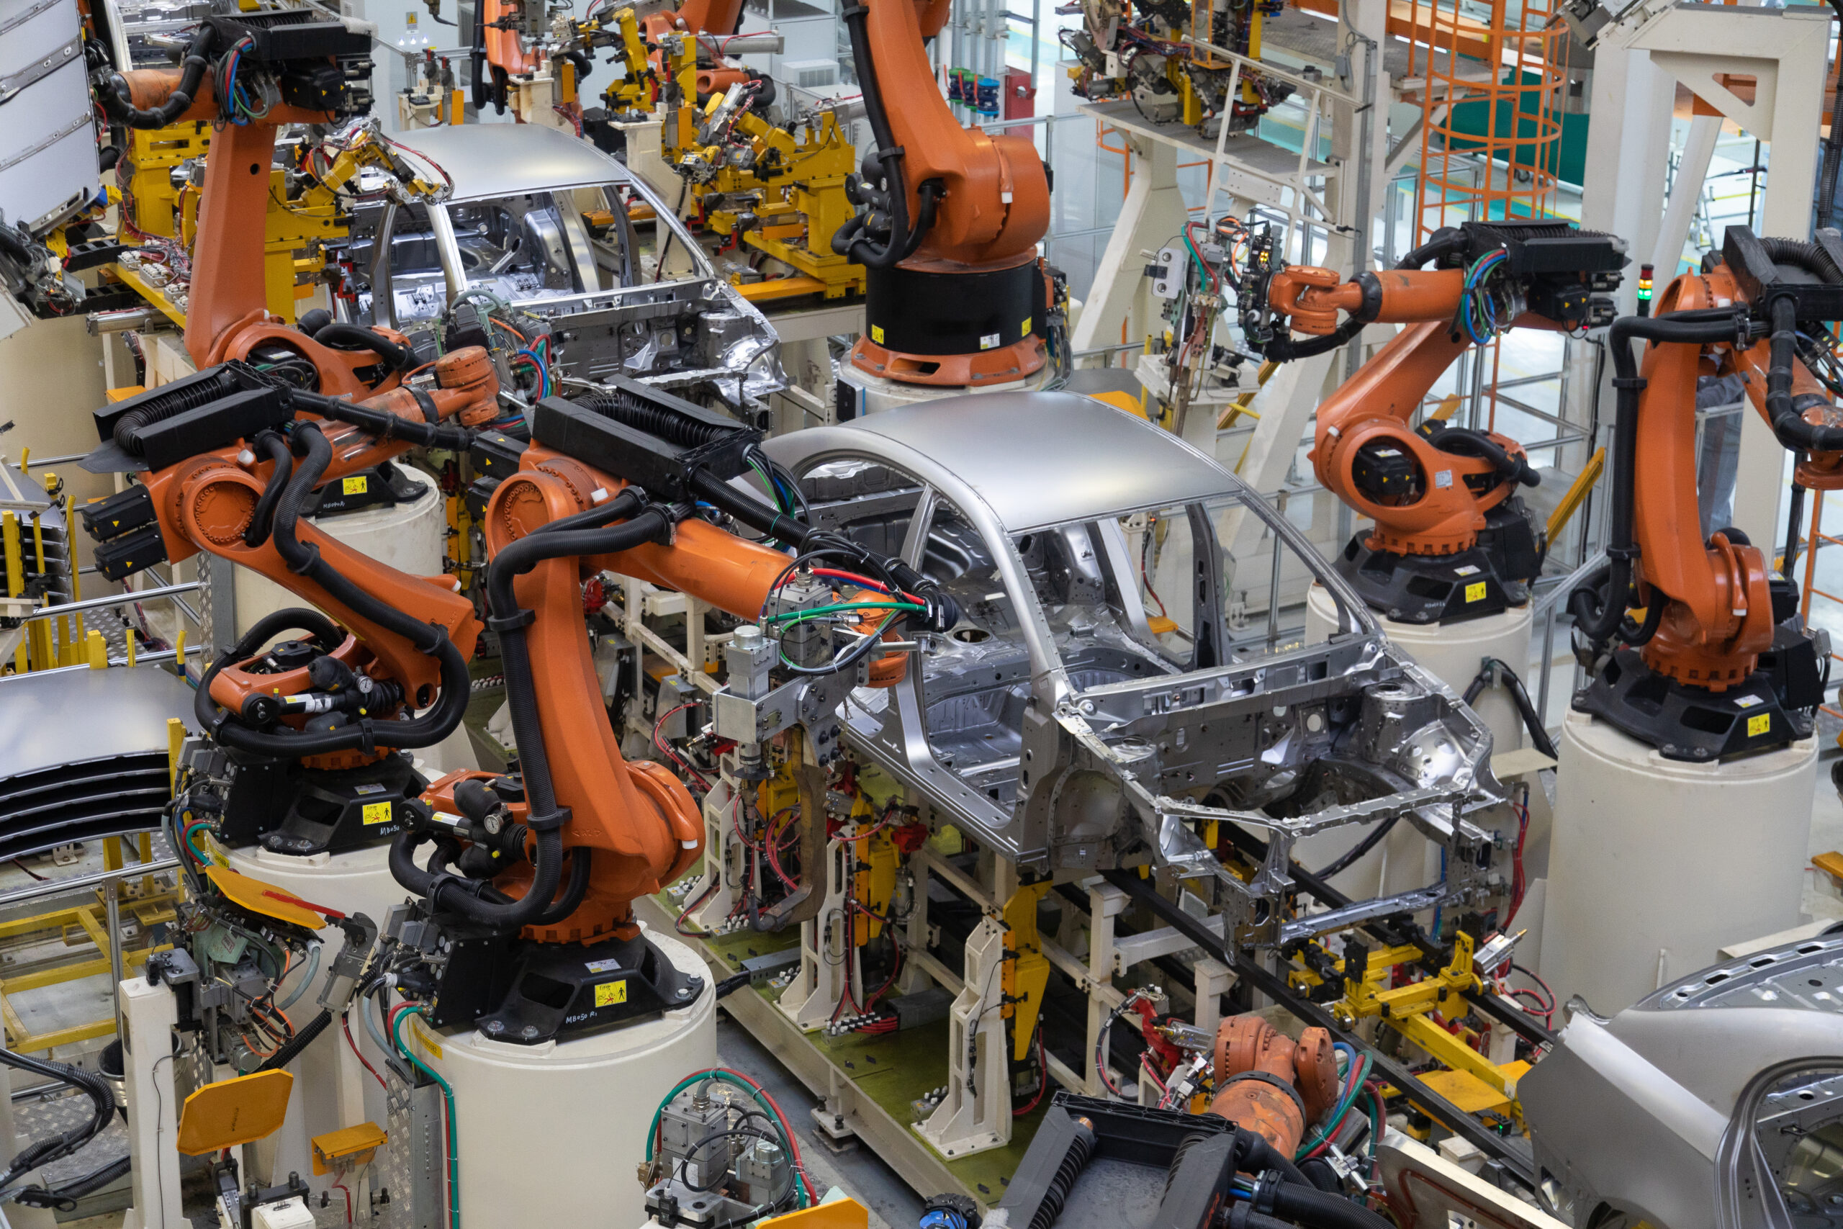
Core Question: Does an active visual sensor significantly improve task performance in 3D environments?
Why? Modern day fabrication and technologies are increasingly funnelling developments into robotics
Introduction
Image Credit: [12] Yosha, B
Image Credit: [13] Hartwig, B.
Notes:
Good afternoon, everyone. My name is Rhys Stewart, and today I'll be presenting my Honours project, which investigates the effects of active vision on Reinforcement Learning models. In essence, I wanted to answer a fundamental question: if we stop giving AI models a perfect, static view of the world and instead force them to actively move a camera to see their environment, do they perform better?
Now, why should be care? In this modern day and age, with the rapid developments and capabilities of AI models, robotics has seen an interest boom, especially in the field of fabrication and autonomous, self-driving cars. To ensure that these applications function well, safety and well-established programmes are paramount. However, with the integration of AI, the field of robotics has seen a setback in terms of robotic capabilities, with further research required before mass integration into society will be seen.

Slide 3
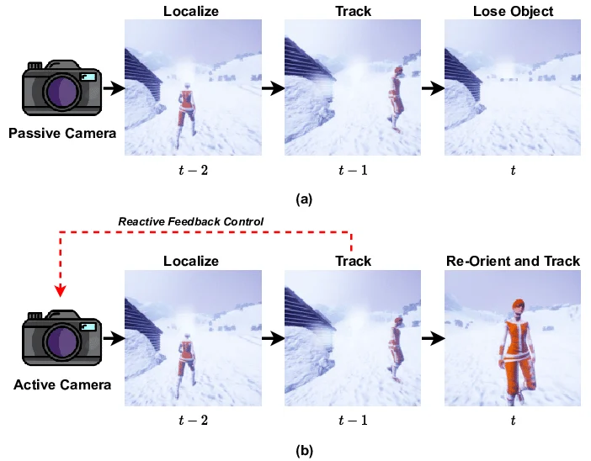
The Problem with Passive Vision
Core Question: Does an active visual sensor significantly improve task performance in 3D environments?
Standard image processing passes full frames into Convolutional Neural Networks (CNNs) without emphasising specific features [2,7]
Traditional perceptions relies on passive, static cameras, with fixed fields of view (FOV). [4,7]
This leaves systems vulnerable to occlusions and limits dynamic target tracking [4]
Image credit: [10] Trehan, Shubham & Aakur, Sathyanarayanan
Notes:
To understand further as to why this project is necessary, we have to look at the limitations of standard computer vision. Traditionally, we used a ‘passive vision’ approach, feeding a full, static, FIXED FOV image into a CNN. For autonomous agents, like robots or self-driving cars, this is a major vulnerability. A fixed camera simply cannot look around an obstacle or dynamically track a moving target outside of its periphery.
The figure presented here shows an excellent example between these two different types of vision systems and why a static camera, when needed for dynamically exploring its environment, is insufficient.

Slide 4
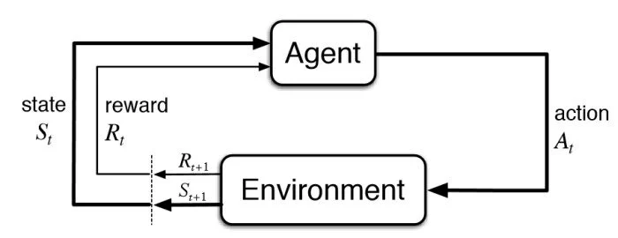
The Active Vision Paradigm
Active vision allows an observer to dynamically manipulate its sensory equipment (e.g., a moving camera) [1, 11]
This mirrors the biological “look to act” principles of human visual behaviour [4]
Deep Reinforcement Learning (DRL) allows an agent to map high-dimensional raw pixels directly to motor control [5]
Image credit: [2] Rabault, J. & Ren, Feng & Zhang, Wei & Tang, Hui & Xu, Hui. (2020).
Notes:
So, what is the solution? Active vision, a concept inspired by human biology; the idea that an observer can solve visual problems much more efficiently if they can move their sensory apparatus – simply, turning your head to see something more clearly. To achieve the same effect, my project utilises DRL, which allows an agent to learn how to map raw pixel inputs directly to camera movements through trial and error – another mimicry of human learning behaviour.

Slide 5
Methodology: The Foveal Bottleneck
Control: A ‘baseline’ model that receives no modifications to its FOV (receives full 160x120 image)
The ‘Active’ model is subjected to a strict informational “bottleneck”, simulating a foveal sensor
The observation space (all that can be possibly perceived) undergoes an aggressive centre-crop
The crop is then rescaled back to the baseline dimensions (160x120) using bilinear interpolation
Control Mechanism: Ensures identical parameter counts between the baseline and active CNN architectures
Notes:
Using our framework, how do we then force an agent to look around? To achieve this, introduced was an informational bottleneck. For the active vision model, I forced a centre-crop of the screen (of varying reduction sizes, all the way down to just 1% of the original screen) and then rescaled it back up to the original image size. This is a crucial methodological control: both the baseline and the active agent have the exact same sized neural network. Because the active agent’s vision is constrained, it literally is forced to pan its camera to build a panoramic understanding of its environment. This is illustrated more clearly on the following slide:

Slide 6
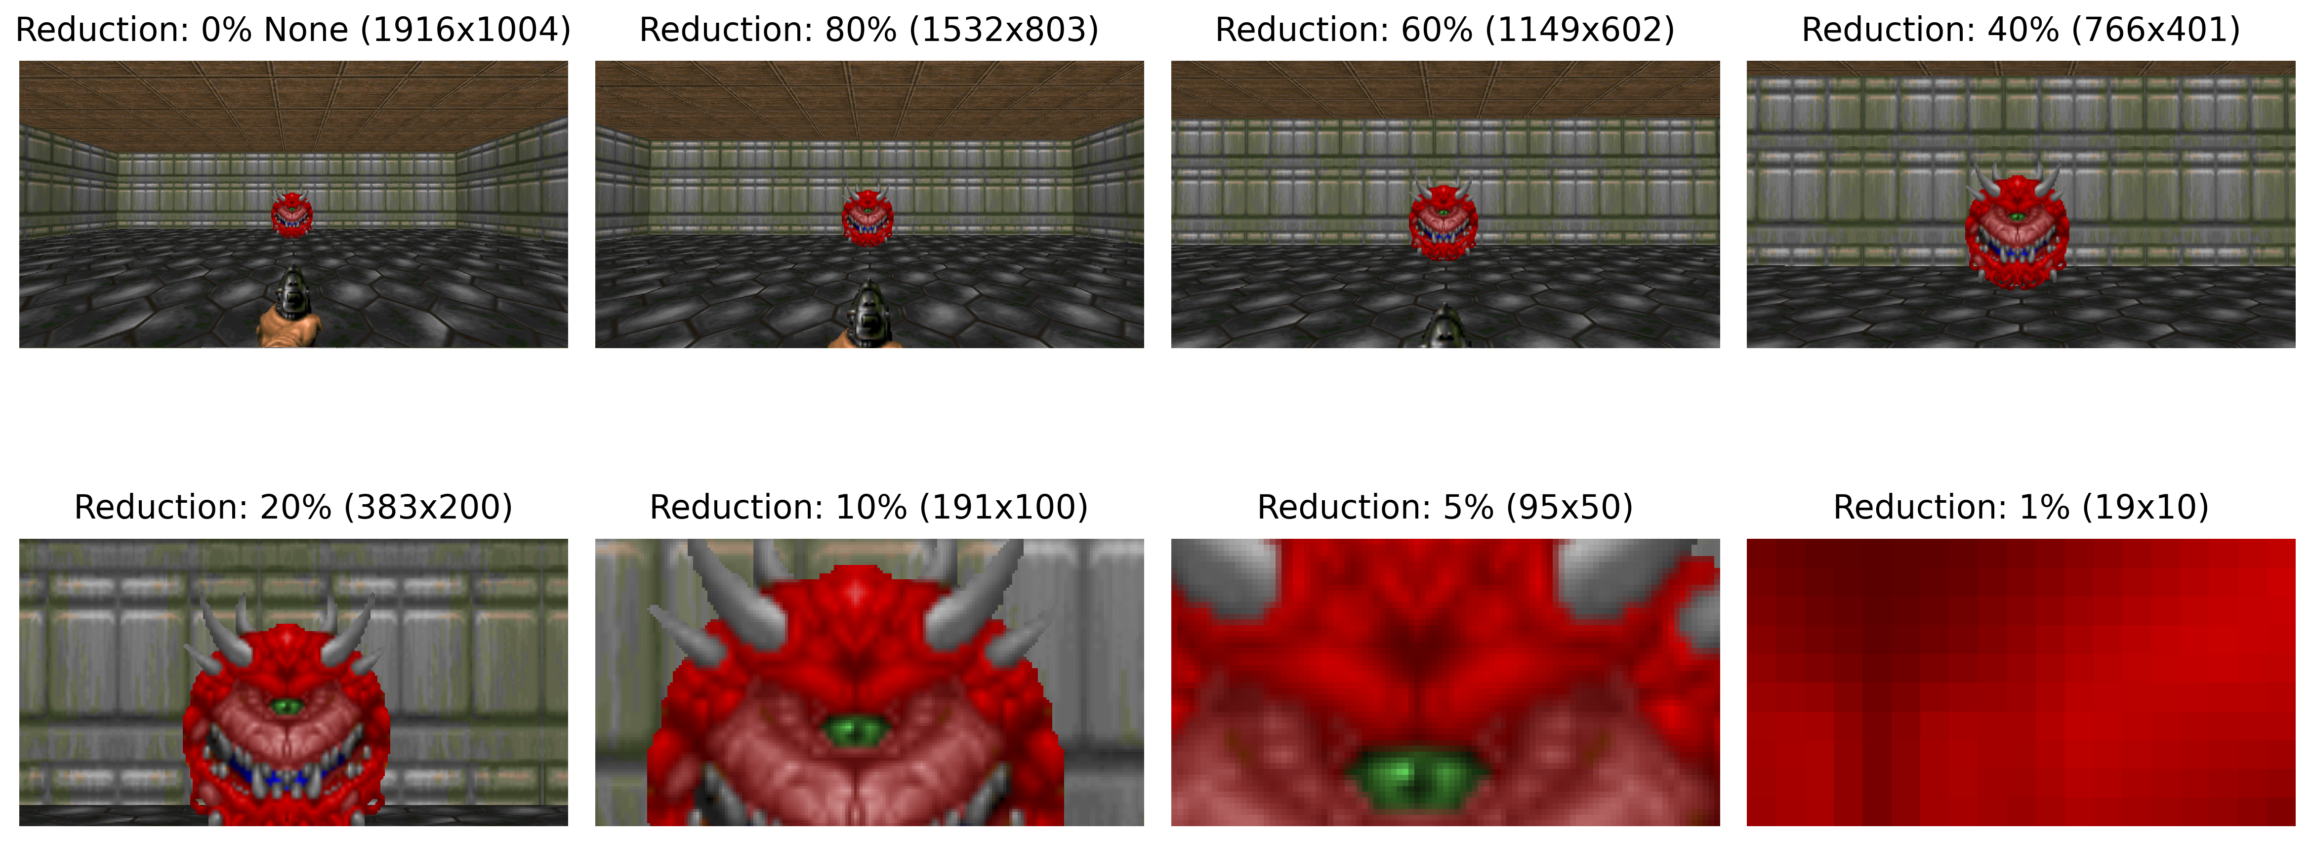
Methodology: Reduced Rescaled FOVs
Notes:
This slide details the specific reduction factors that I had placed onto the screen buffer fed into the agent’s architecture. Investigated were No reduction, 80% of the image retained, 60%, 40%, … down to just 1%. Now, this image begins as a much larger size, for illustration purposes

Slide 7
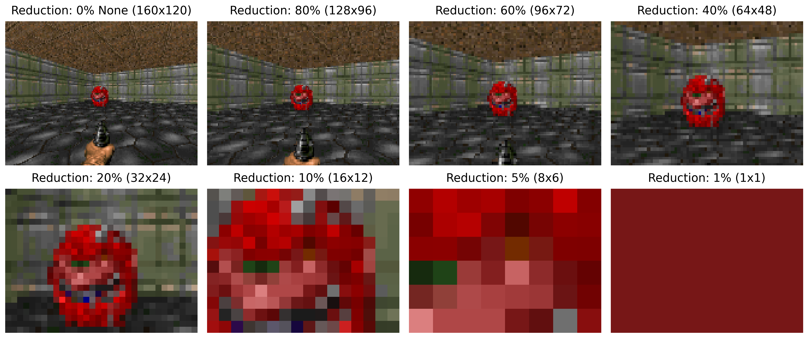
Methodology: Reduced Rescaled FOVs
Notes:
This figure provides a more 1:1 visualisation towards that of what the agent sees. These reductions mean that at 1%, all the model is provided with is a single pixel.

Slide 8
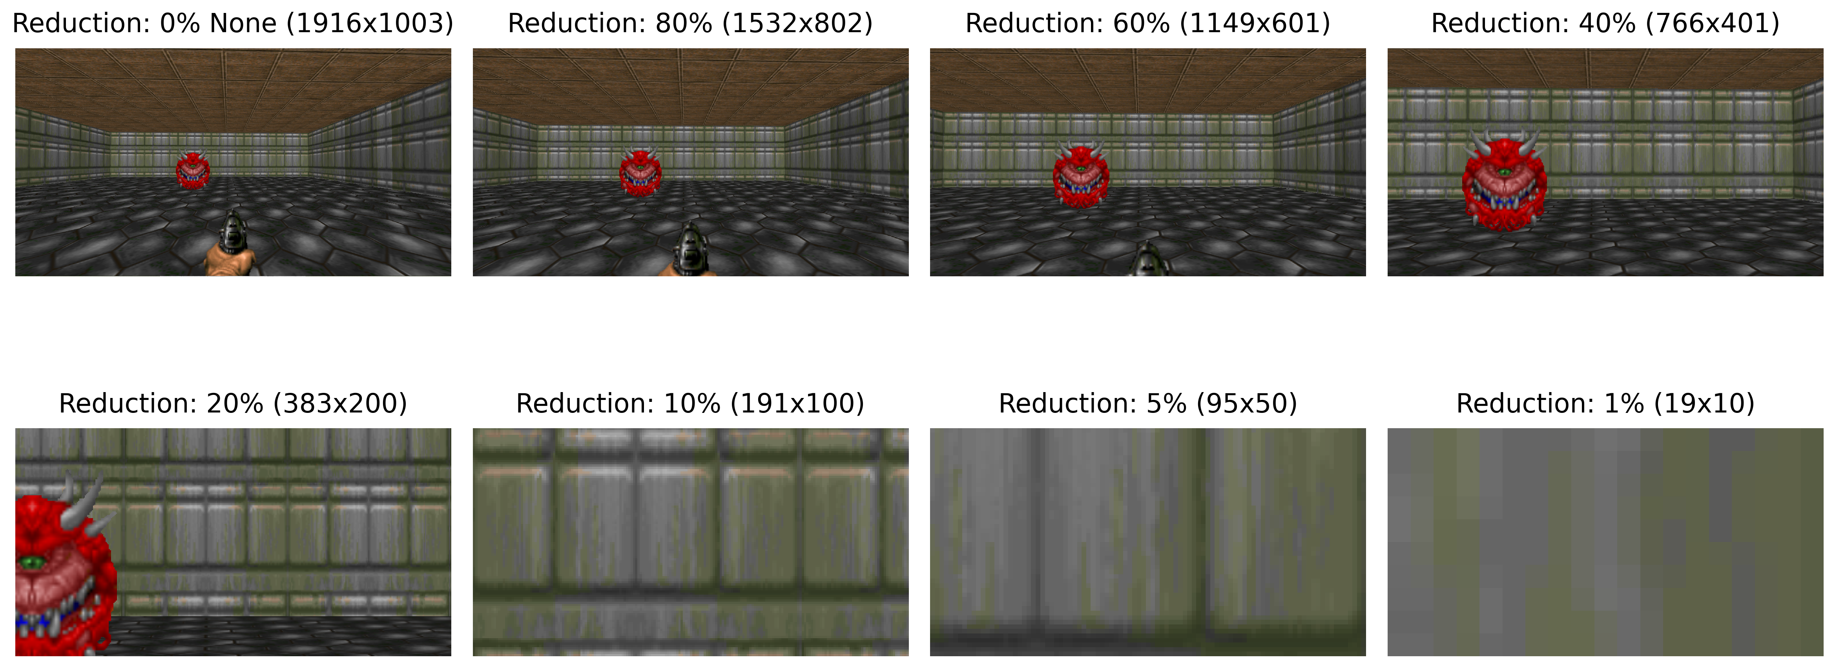
Methodology: Reduced Rescaled FOVs
Notes:
This slide illustrates why the agent would have to move its visual sensor in order to locate the cacodemon in heavily reduced FOVs

Slide 9
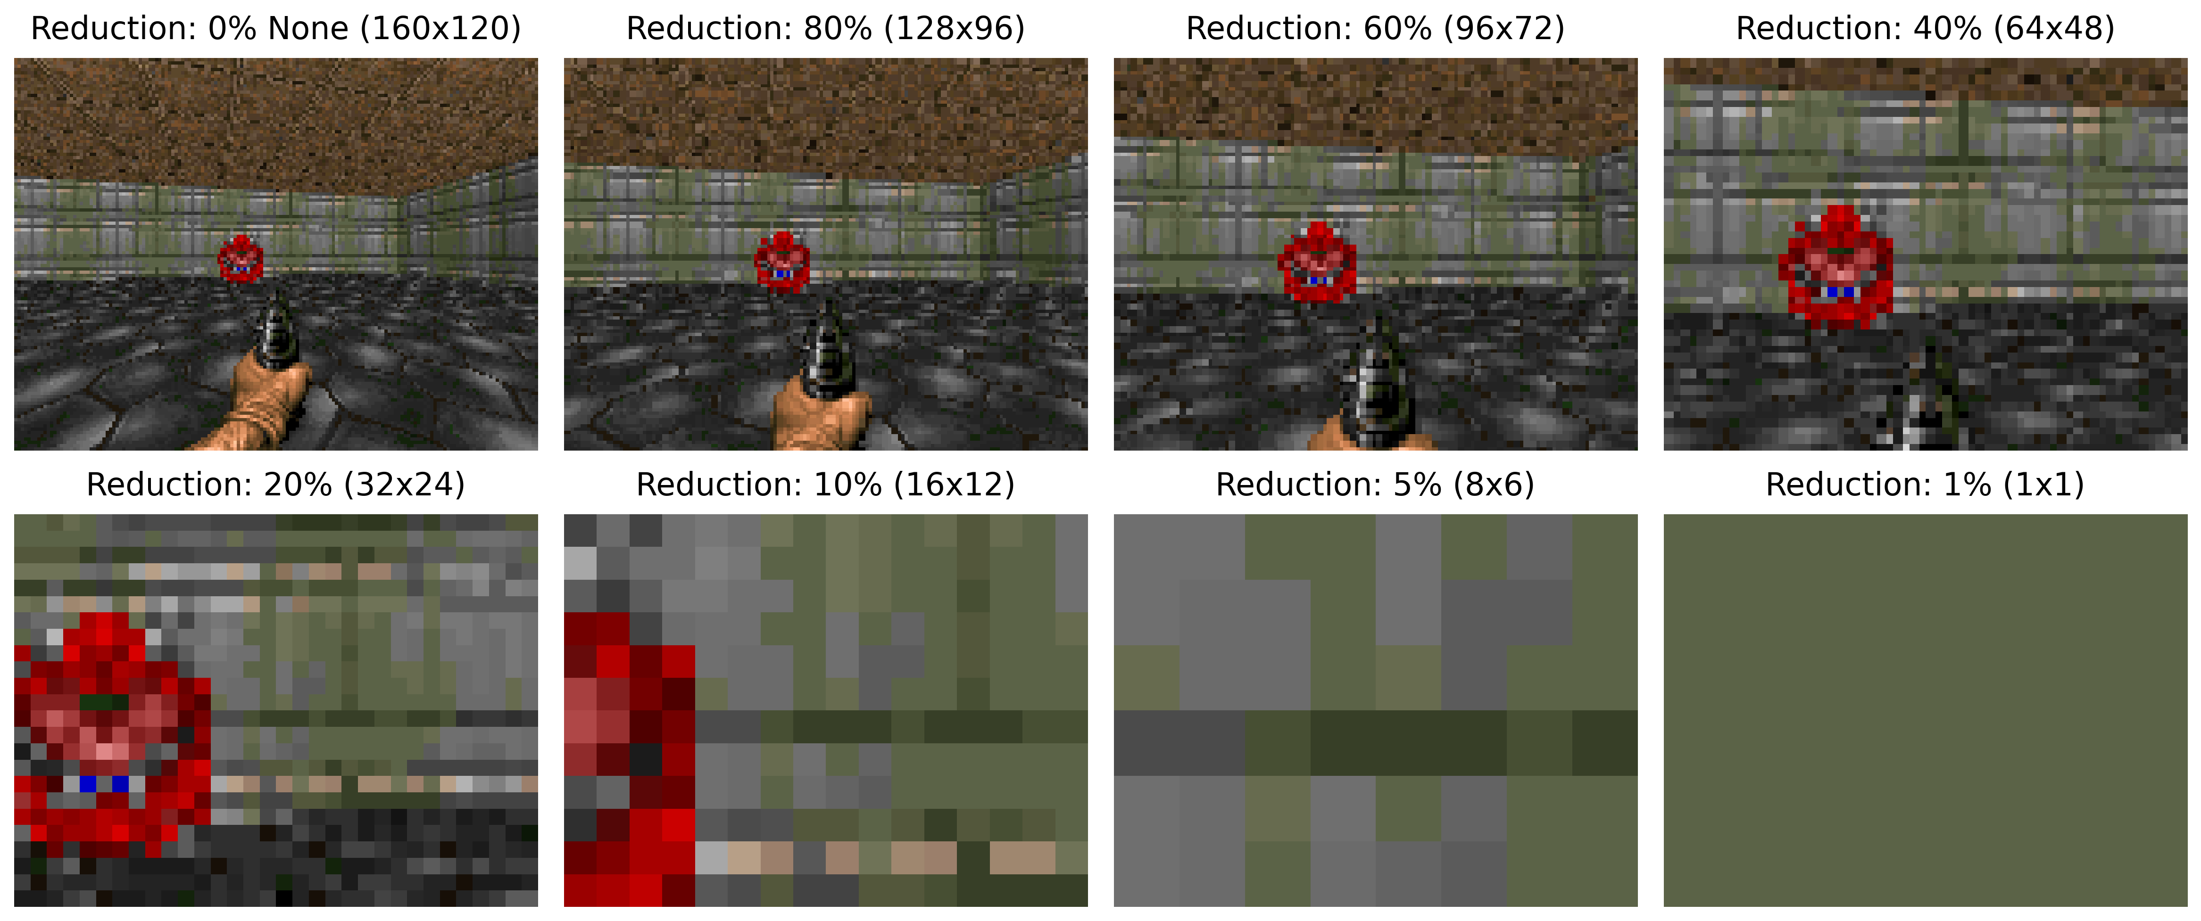
Methodology: Reduced Rescaled FOVs
Notes:
This figure provides a more 1:1 visualisation towards that of what the agent sees. These reductions mean that at 1%, all the model is provided with is a single pixel.

Slide 10
Implementation
ViZDoom: A 3D AI research platform providing raw-pixel input and partial observability [3]
Gymnasium API: Standardises the RL environment interfaces [8]
Stable-Baselines3: Implements Proximal Policy Optimisation (PPO) [9]
PPO utilises an Actor-Critic architecture and clipped probability ratios to ensure stable training (learning)
Notes:
Now, Implementing this scenario came at the integration of three major technologies.
ViZDoom as the 3D physics engine as it supports raw-pixel input.
The Gymnasium API to standardise the inputs and outputs, such that there were no discrepancies in how the underlying architecture was being handled
Finally, the agent’s “brain” is powered by the PPO architecture, provided by SB3
PPO was specifically chosen because its mathematical clipping operations prevents destructively large policy updates, ensuring stable training directly from pixels.

Slide 11
Scenario Design & Evaluation Pipeline
A custom “Cacodemon Recognition” scenario was developed using Action Code Script (ACS) for dynamic randomisation of enemy placement
Level 1 (Basic): A sterile control map for training visuomotor mapping
Level 2 (Intermediate): Introduces visual clutter and non-target distractors
Level 3 (Final): Unseen geometry and novel enemy types to test zero-shot generalisation (i.e. how well it performs on an unseen task)
Notes:
The physical implementation came from the development of a custom scenario I have termed “Cacodemon Recognition”. The goal of this task is simple: “Locate the Cacodemon enemy and kill it”. To rigorously test this, an agent is independently exposed to three different levels.

Slide 12
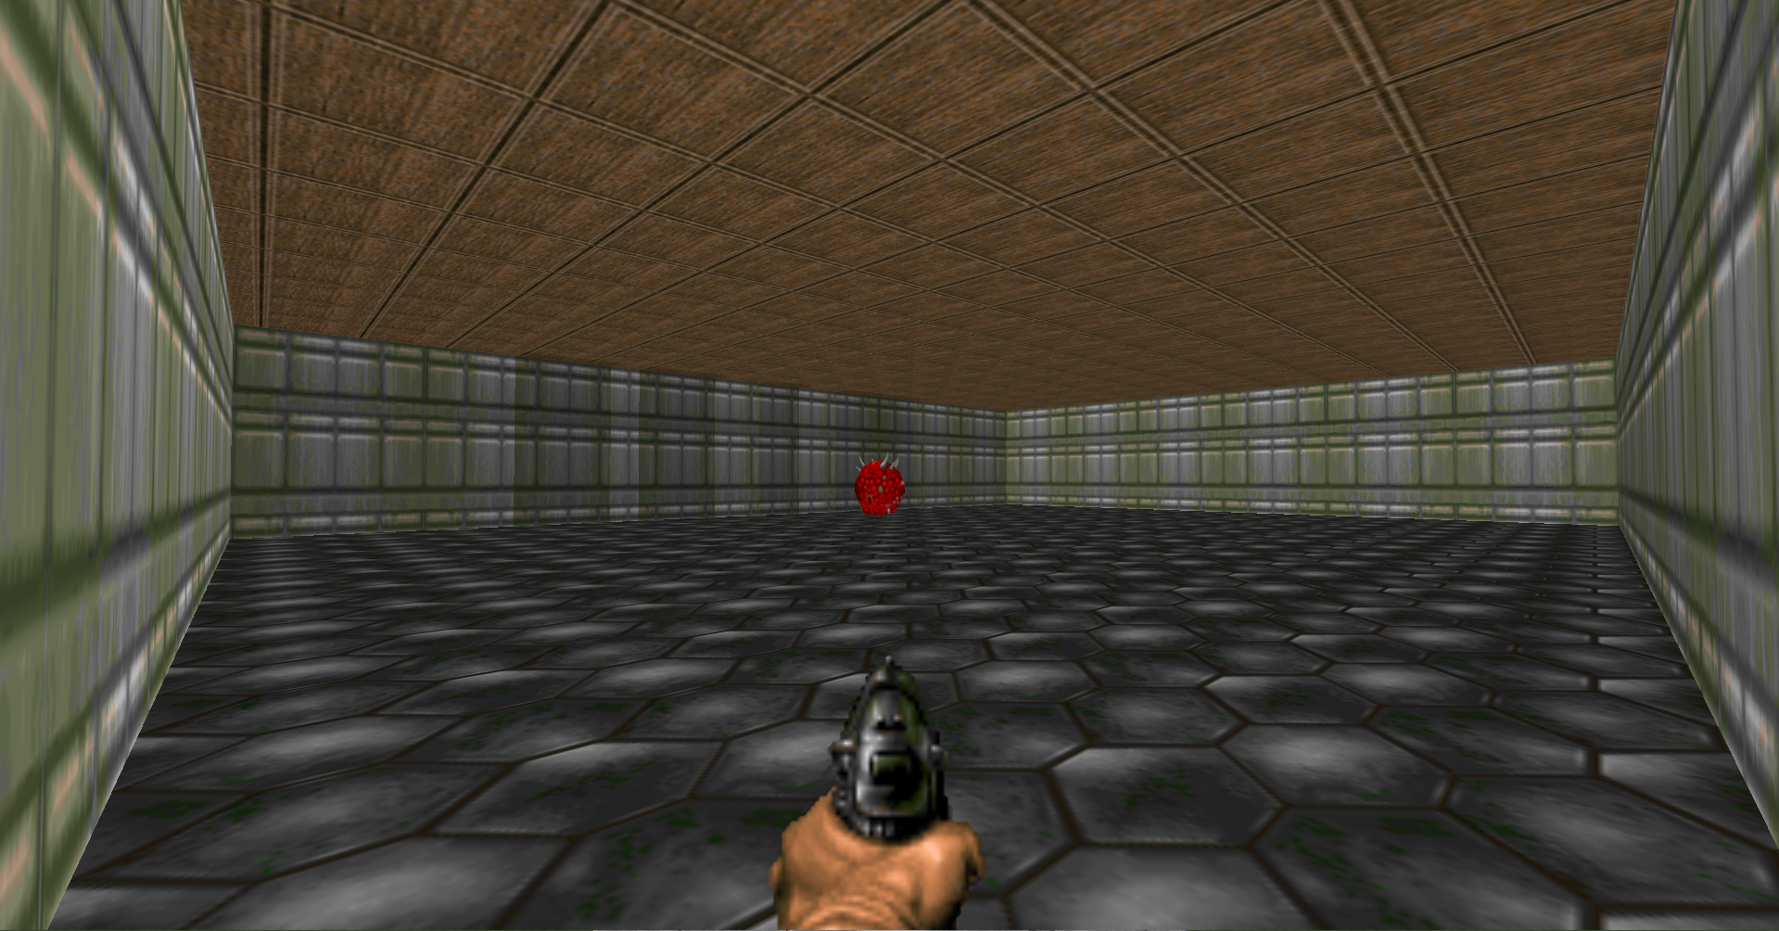
Level 1
Notes:
Level 1 is a sterile control room, where basic motor control learning is tested. This room features uniform wall and ceiling textures and a single cacodemon enemy placed randomly per episode

Slide 13
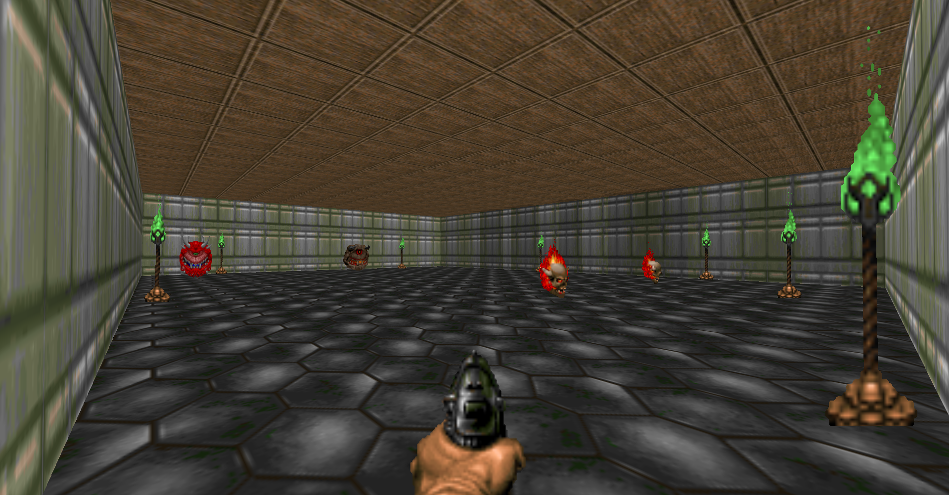
Level 2
Notes:
Level 2 is the same geometrically, now with the addition of torches placed around the map to add visual clutter and additional enemies to add task occlusion

Slide 14
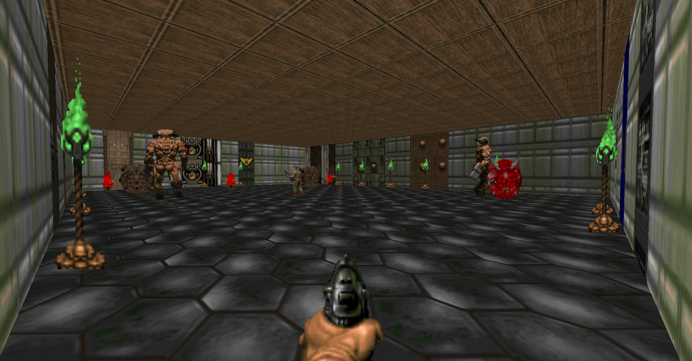
Level 3
Notes:
Level 3 is a larger map, featuring varying unseen wall textures, torches, and a further addition of enemies

Slide 15
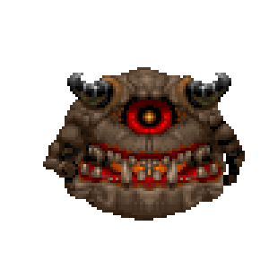
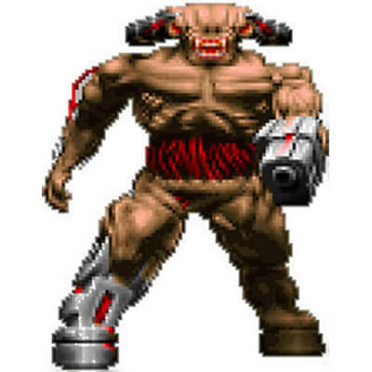
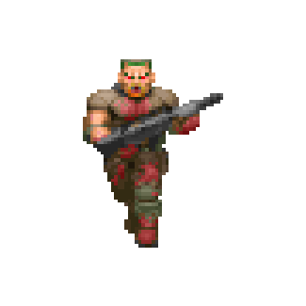

Cacodemon Recognition: Enemies List
The Cacodemon
The Pain Elemental
The Cyberdemon
The Zombieman
The Lost Soul
Notes:
This slide features all the different types of enemies that were used throughout the different levels of the Cacodemon Recognition Scenario.
The Pain Elemental and the Lost Soul were specifically chosen to be challenging distractors for the agent, both floating orbs which contain shades of red in them.

Slide 16
Reward Engineering: Training
Target Elimination: +10
Non-Target Elimination: -20
Living Penalty: -0.1 per second (speed incentive)
Target Alignment: Fractional reward of up to +0.05 based on Euclidean distance
Camera Turning (Active Only): +0.05 per turn to encourage scanning
Notes:
The following lists the reward structure provided to agent’s during training, carefully tuned to guide the agent in the right direction without doing the work for it. Specifically, to prevent the agent from just spinning in circles to farm points, a strict schedule was prescribed. Killing the right target gives a positive reward of +10, but shooting the wrong enemy provides a heavy penalisation of -20. Crucially, rather than giving the agent the coordinates of the enemy, I calculates a fractional alignment reward based on the Euclidean distance from the target to the centre of the screen, gently guiding the camera towards desired behaviour.

Slide 17
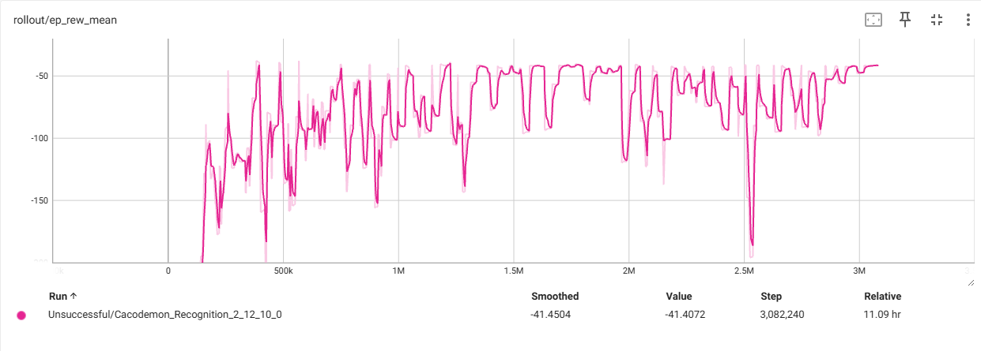
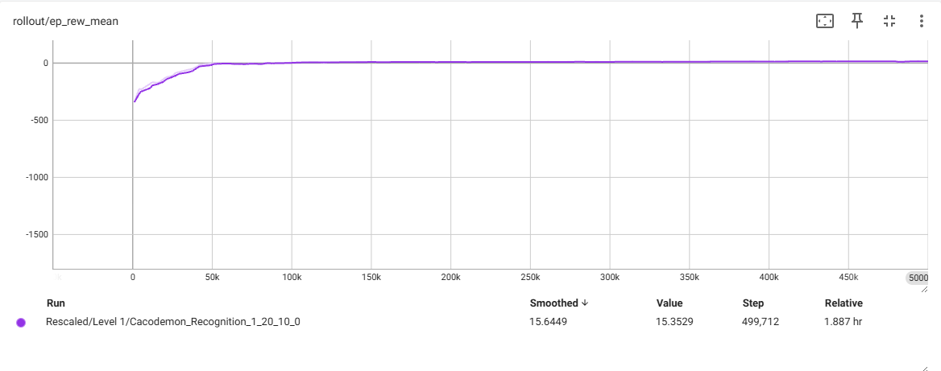
Findings & Catastrophic Forgetting
Extreme FOV reductions (<= 20%) initially suffered from policy collapse
Sparse target visibility caused gradient signals to “wash out” during large batch updates
This was addressed via dynamic hyperparameter scaling (reduced batch sizes and increased entropy)
Notes:
The implementation wasn’t without its challenges, however. When I had initially reduced the agent’s FOV to the extreme levels (like 10% and 1%), the models exhibited catastrophic forgetting – the eradication of (good) previously learned behaviour. Since the target was only visible in a tiny fraction of the frames, the gradient signal was washed out by frames of (empty) walls during training. I overcame this by dynamically scaling the hyperparameters; reducing batch sizes and increasing the entropy coefficient to force exploration over immediate reward, allowing even the most heavily blinded agents to learn.
The second graph displayed here is the retuned hyperparameters, showing steady and successful learning.

Slide 18
Evaluation: Reward Structure
Each model type, level, and level condition was run 100 times each, with results saved to disk. Including evaluation on trained level and evaluation on unseen levels across all conditions.
Evaluations were prescribed a strict reward structure:
  Killing Target: +20
  Killing Non-Target: -20
  Living: -1
  Bullet Shot: -1
Notes:
As the active models have a slightly different possible maximum reward, additional reward structures were removed during evaluation. This leaves us with just the principal rewards for target/non-target elimination, using the weapon, and living.

Slide 19
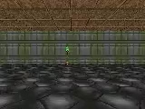
Trained Model Demonstrations
Active Model – Reduction 1%, trained level 2, evaluated level 2
Baseline Model – Trained level 2, evaluated level 2
Notes:
As the active models have a slightly different possible maximum reward, additional reward structures were removed during evaluation. This leaves us with just the principal rewards for target/non-target elimination, using the weapon, and living.

Slide 20
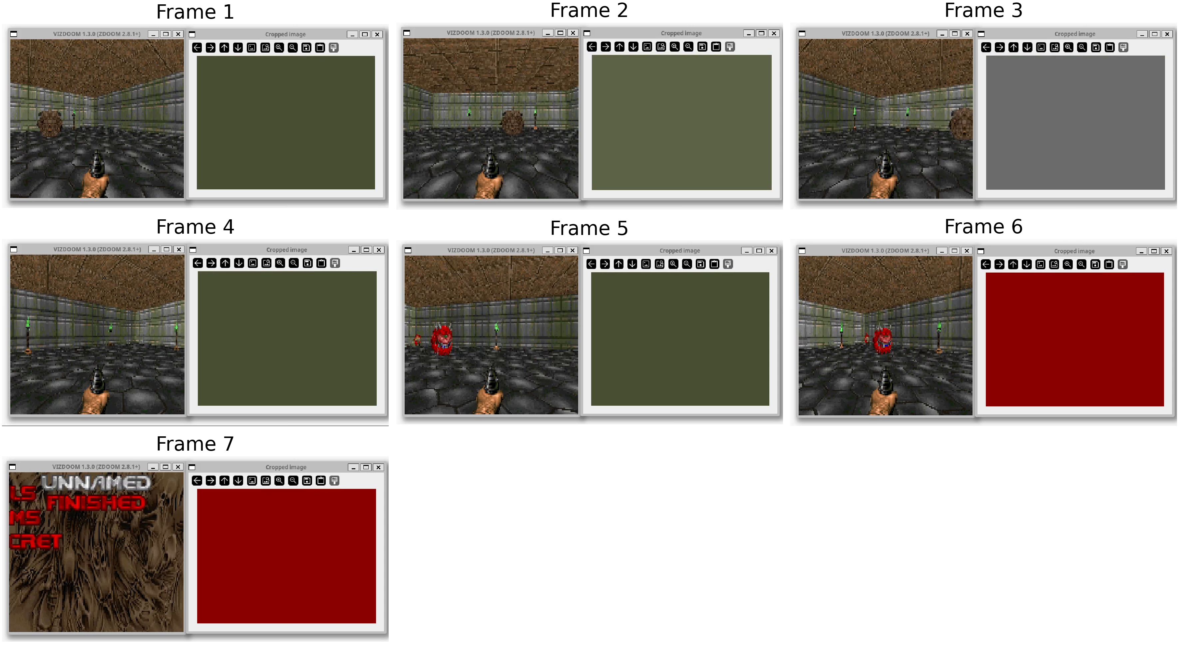
Trained Model Demonstrations
Notes:
Side-by-side frame by frame active vision model with 1% FOV (right) with the actual game screen (left)

Slide 21
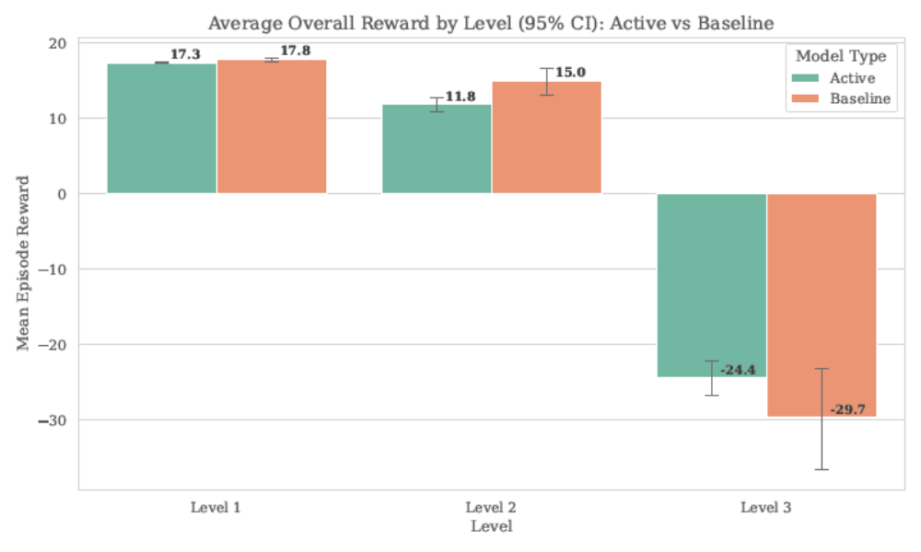
Mean Model Performance
Notes:
In the 1:1 evaluations, it can be seen here that the baseline slightly outperforms the active model, on average. However, when evaluating model generalisation (e.g. Model Type Level {1,2} on Levels {1,2,3}), the active models perform higher on average

Slide 22
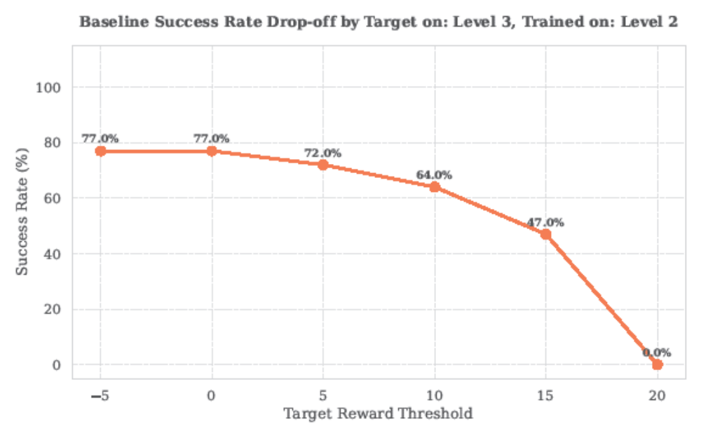
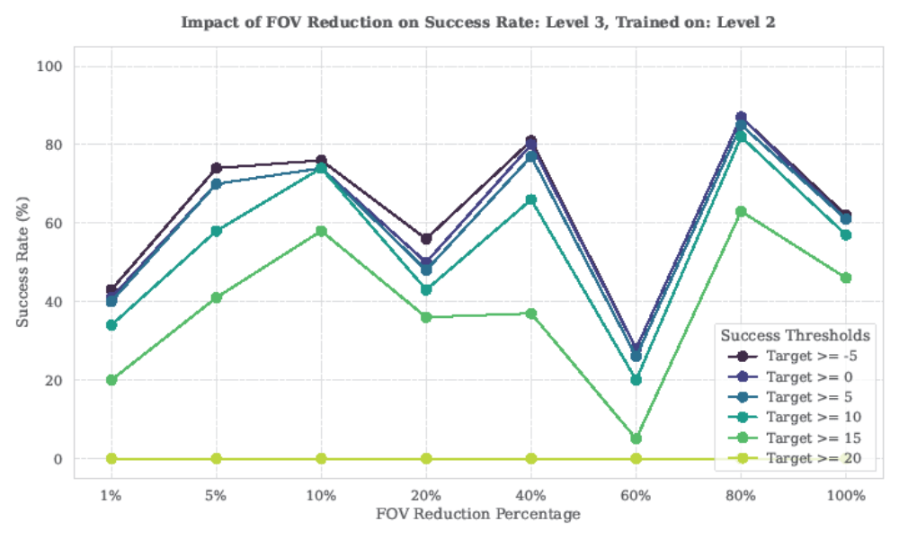
Model Performance: Generalisability
Notes:
In the 1:1 evaluations, it can be seen here that the baseline slightly outperforms the active model, on average. However, when evaluating model generalisation (e.g. Model Type Level {1,2} on Levels {1,2,3}), the active models perform higher on average

Slide 23
Conclusion & Future Work
Active camera movement provides a reproducible alternative to passive CNN paradigms (i.e. passive, static viewpoints)
The framework utilised successfully integrates ViZDoom, Gymnasium, and SB3 for future active vision benchmarking, providing a baseline to the field
There are endless possibilities for future work, through expansion towards more complex action spaces, and sim to real transfer, putting trained simulations into real-world robotics (for extensions of this project, see next slide)
Notes:
Thus, in summary, this project successfully demonstrates that we can isolate and evaluate the raw impact of foveated active vision. By integrating ViZDoom, Gymnasium, and SB3, I have created a fully reproducible benchmarking framework for for testing active vision perception against standard passive models. This lays the groundwork for overcoming the spatial limitations of standard CNNs, with future potential for testing continuous 3D movement and real-world robotics.
The framework also addresses a gap in the current literature and documentation, providing a concrete instance of an integration across these technologies

Slide 24
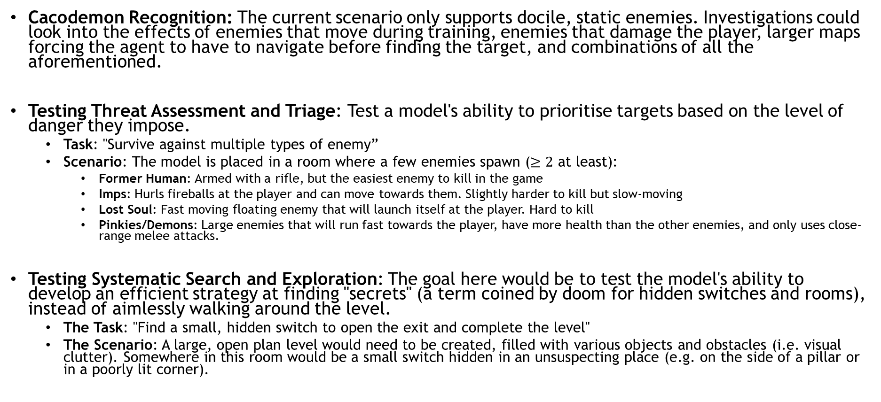
Conclusion & Future Work
Cacodemon Recognition: The current scenario only supports docile, static enemies. Investigations could look into the effects of enemies that move during training, enemies that damage the player, larger maps forcing the agent to have to navigate before finding the target, and combinations of all the aforementioned.
Testing Threat Assessment and Triage: Test a model's ability to prioritise targets based on the level of danger they impose.
  Task: "Survive against multiple types of enemy”
  Scenario: The model is placed in a room where a few enemies spawn ($≥2$ at least):
    Former Human: Armed with a rifle, but the easiest enemy to kill in the game
    Imps: Hurls fireballs at the player and can move towards them. Slightly harder to kill but slow-moving
    Lost Soul: Fast moving floating enemy that will launch itself at the player. Hard to kill
    Pinkies/Demons: Large enemies that will run fast towards the player, have more health than the other enemies, and only uses close-range melee attacks.
Testing Systematic Search and Exploration: The goal here would be to test the model's ability to develop an efficient strategy at finding "secrets" (a term coined by doom for hidden switches and rooms), instead of aimlessly walking around the level.
  The Task: "Find a small, hidden switch to open the exit and complete the level"
  The Scenario: A large, open plan level would need to be created, filled with various objects and obstacles (i.e. visual clutter). Somewhere in this room would be a small switch hidden in an unsuspecting place (e.g. on the side of a pillar or in a poorly lit corner).
Notes:
Thus, in summary, this project successfully demonstrates that we can isolate and evaluate the raw impact of foveated active vision. By integrating ViZDoom, Gymnasium, and SB3, I have created a fully reproducible benchmarking framework for for testing active vision perception against standard passive models. This lays the groundwork for overcoming the spatial limitations of standard CNNs, with future potential for testing continuous 3D movement and real-world robotics.
The framework also addresses a gap in the current literature and documentation, providing a concrete instance of an integration across these technologies

Slide 25
Bibliography
[1] Aloimonos, J., Weiss, I. and Bandyopadhyay, A. (1988), ‘Active vision’, International Journal ofComputer Vision 1(4), 333–356.URL: https://doi.org/10.1007/BF00133571
[2] Chuang, I., Lee, A., Gao, D., Naddaf-Sh, M.-M. and Soltani, I. (2025), ‘Active Vision Might BeAll You Need: Exploring Active Vision in Bimanual Robotic Manipulation’. arXiv:2409.17435[cs].URL: http://arxiv.org/abs/2409.17435
[3] Kempka, M., Wydmuch, M., Runc, G., Toczek, J. and Jaśkowski, W. (2016), ViZDoom: ADoom-based AI research platform for visual reinforcement learning, in ‘2016 IEEE Conferenceon Computational Intelligence and Games (CIG)’, pp. 1–8.URL: https://ieeexplore.ieee.org/document/7860433/
[4] Kerr, J., Hari, K., Weber, E., Kim, C. M., Yi, B., Bonnen, T., Goldberg, K. and Kanazawa,A. (2025), ‘Eye, Robot: Learning to Look to Act with a BC-RL Perception-Action Loop’.arXiv:2506.10968 [cs].URL: http://arxiv.org/abs/2506.10968
[5] Li, Z. (2024), ‘Advances in Deep Reinforcement Learning for Computer Vision Applications’,Journal of Industrial Engineering and Applied Science 2(6), 16–26.URL: https://www.suaspress.org/ojs/index.php/JIEAS/article/view/v2n6a03
[6] Rabault, J. & Ren, Feng & Zhang, Wei & Tang, Hui & Xu, Hui. (2020). DEEP REINFORCEMENT LEARNING IN FLUID MECHANICS: A PROMISING METHOD FOR BOTH ACTIVE FLOW CONTROL AND SHAPE OPTIMIZATION. 10.13140/RG.2.2.29692.28800.
[7] Rangel, G., Cuevas-Tello, J. C., Nunez-Varela, J., Puente, C. and Silva-Trujillo, A. G.(2024), ‘A Survey on Convolutional Neural Networks and Their Performance Lim-itations in Image Recognition Tasks’, Journal of Sensors 2024(1), 2797320. _eprint:https://onlinelibrary.wiley.com/doi/pdf/10.1155/2024/2797320.URL: https://onlinelibrary.wiley.com/doi/abs/10.1155/2024/2797320
[8] Raffin, A., Hill, A., Gleave, A., Kanervisto, A., Ernestus, M. and Dormann, N. (2021), ‘Stable-Baselines3: Reliable Reinforcement Learning Implementations’, 22, 1–8.URL: https://jmlr.org/papers/volume22/20-1364/20-1364.pdf
[9] Towers, M., Kwiatkowski, A., Terry, J., Balis, J. U., Cola, G. D., Deleu, T., Goulão, M., Kallinteris,A., Krimmel, M., KG, A., Perez-Vicente, R., Pierré, A., Schulhoff, S., Tai, J. J., Tan, H.and Younis, O. G. (2025), ‘Gymnasium: A Standard Interface for Reinforcement LearningEnvironments’. arXiv:2407.17032 [cs].URL: http://arxiv.org/abs/2407.17032
[10] Trehan, Shubham & Aakur, Sathyanarayanan. (2021). Towards Active Vision for Action Localization with Reactive Control and Predictive Learning. 10.48550/arXiv.2111.05448.
[11] Wechsler, H. (1990), Active Perception, in ‘Computational Vision’, Elsevier, pp. 248–300.URL: https://linkinghub.elsevier.com/retrieve/pii/B9780127412450500129
[12] Yosha, B.. 5 Top Self-Driving Car Manufacturers [Internet]. Yosha Law Firm - Personal Injury Lawyers. 2023 Feb [cited 2026 Mar 23]. Available from: https://yoshalawfirm.com/blog/5-top-self-driving-car-manufacturers/
[13] Hartwig, B.. 7 key robot applications in automotive manufacturing [Internet]. The Robot Report. 2019 Nov [cited 2026 Mar 23]. Available from: https://www.therobotreport.com/7-key-robot-applications-in-automotive-manufacturing/

Slide 26
Thank you
Any Questions?

Slide 27
Glossary
Action Code Script (ACS): The native scripting language used in the ViZDoom engine to dictate map logic, entity behaviors, spawn randomizations, and environmental states.
Active Vision: A perception paradigm where an observer dynamically manipulates its sensory apparatus (e.g., panning a camera) to solve visual problems more efficiently. It relies on biological "look to act" principles to overcome the limitations of fixed viewpoints.
Actor-Critic Architecture: A neural network design used in reinforcement learning that is bifurcated into two heads: the Actor (which chooses actions based on the current policy) and the Critic (which evaluates the state to guide and stabilize the Actor's learning).
Batch Size: A machine learning hyperparameter that determines the number of training samples processed in a single pass before updating the internal parameters of the neural network.
Bilinear Interpolation: A mathematical image-processing technique used to resize an image. In this project, it is used to scale the tightly cropped foveal image back up to the original 160 x 120 resolution to maintain a consistent neural network size.
Catastrophic Forgetting: A phenomenon where a neural network abruptly and completely forgets previously learned information (such as how to attack a target) upon learning new information or undergoing a destructively large weight update.
Clipped Probability Ratios: A mathematical technique used by the PPO algorithm to constrain the ratio of a new policy to an old policy within a specific interval (typically [1 + ε, 1 – ε] ). This prevents destructively large updates and ensures stable learning.
Convolutional Neural Network (CNN): A class of deep neural networks commonly used to analyze visual imagery. It operates by passing raw pixel data through layers of filters to extract spatial hierarchies and recognize shapes or objects.
Confidence Interval: a range of values, derived from sample data, that is likely to contain the value of an unknown population parameter (such as a mean or proportion). It quantifies uncertainty by providing a point estimate plus or minus a margin of error, usually at a 95% confidence level (This indicates that if the same study were repeated multiple times, the resulting interval would contain the true population parameter 95% of the time.)
Deep Reinforcement Learning (DRL): A subfield of machine learning that combines artificial neural networks with reinforcement learning, allowing an agent to learn optimal policies directly from high-dimensional, complex inputs like raw screen pixels.
Entropy Coefficient: A hyperparameter in reinforcement learning algorithms that encourages the agent to explore its environment by penalizing overly predictable or deterministic actions.

Slide 28
Glossary
Proximal Policy Optimization (PPO): An industry-standard reinforcement learning algorithm developed by OpenAI. It balances ease of tuning, sample complexity, and training stability by strictly controlling how much the policy can change in a single update.
Reinforcement Learning (RL): An area of machine learning where an agent learns to make decisions by performing actions in an environment to maximize a cumulative numerical reward.
Stable-Baselines3 (SB3): A popular open-source library built on PyTorch that provides highly reliable, benchmarked implementations of deep reinforcement learning algorithms (like PPO).
ViZDoom: A 3D AI research platform based on the classic DOOM game engine. It allows agents to navigate and interact using purely raw-pixel screen buffers and supports highly customizable scenario building.
Visuomotor Mapping: The fundamental, learned connection between visual inputs (what the agent's camera sees) and motor outputs (how the agent physically moves or reacts).
Zero-Shot Generalization: The ability of a machine learning model to successfully perform a task or recognize objects in an entirely new, unstructured environment that it has never encountered during its training phase.
Euclidean Distance: The straight-line physical distance between two points in space. Used in this project's reward engineering to calculate how perfectly aligned the agent's camera is with the center of the target enemy.
Field of View (FOV): The extent of the observable world that is seen at any given moment through a camera or visual sensor.
Foveation (Foveal Sensor): A visual mechanism inspired by biology where the center of the gaze maintains high resolution and detail, while peripheral vision is heavily reduced, cropped, or discarded.
Gymnasium API: A standardized, open-source programming interface used for developing, standardizing, and comparing reinforcement learning environments.
Informational Bottleneck: A deliberate restriction placed on a model's input data (e.g., aggressively cropping the edges of an image) to force the network to develop highly specific, robust behaviors like active camera scanning.
Passive Vision: A traditional computer vision approach where models analyze static, full-resolution images from a fixed camera perspective without the ability to dynamically alter their viewpoint to see around occlusions.

